Slide 1
Wood Works - Design
Jonathan Barnett, Sergey Chibizov, Brad Cross
10/15/2014

Slide 2
Contents
Changes Between Iterations
Overview
Individual Requirements
Demo
Questions

Slide 3
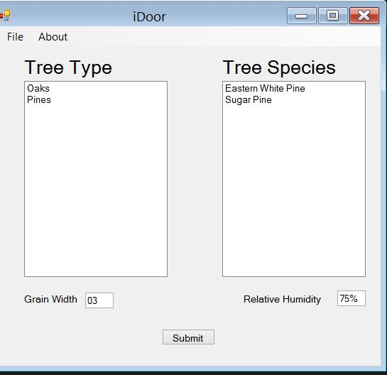
Changes Between Iterations
List of Categories
List of Species
User Input

Slide 4
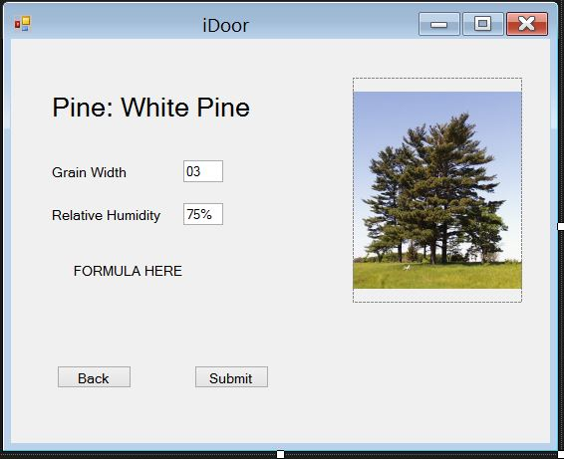
Changes Between Iterations Cont…
Output

Slide 5
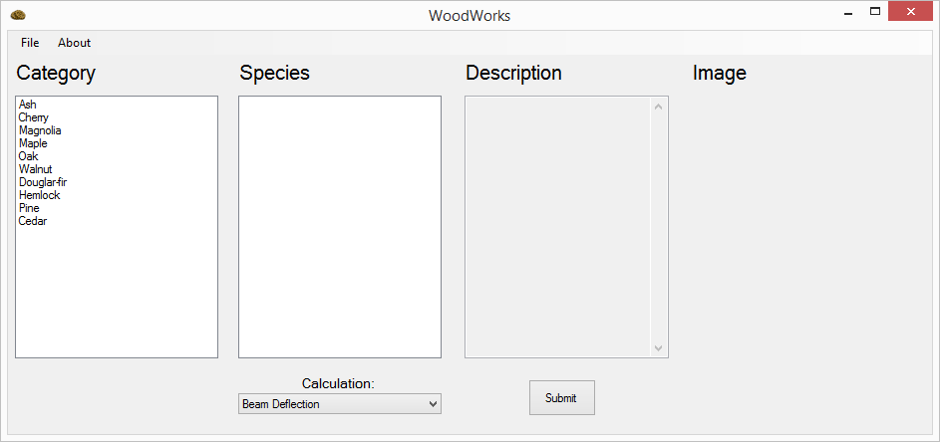
Overview
List of Categories
List of Species for Selected Category
Detailed Description of Selected Species
wood grain image
Type of Calculation

Slide 6
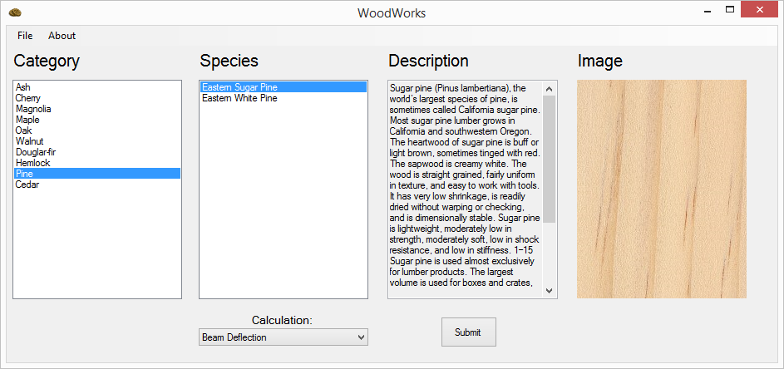
Wood Selection
Select Category
Select Species

Slide 7
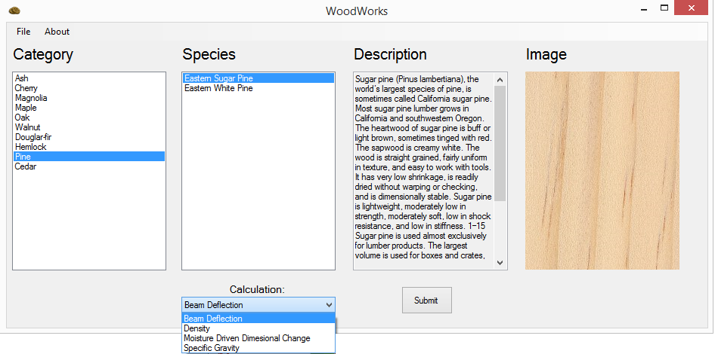
Calculation Selection
Select Type of Calculation
Click Submit

Slide 8

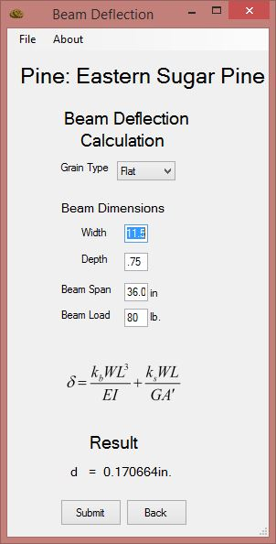
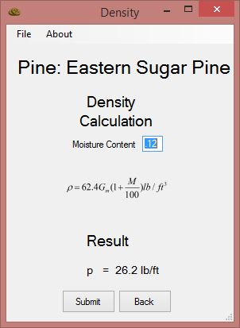
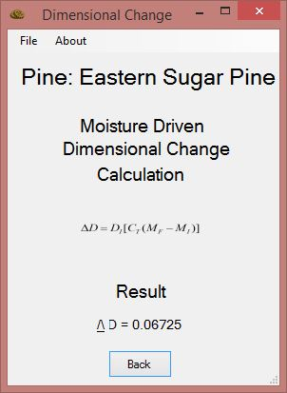
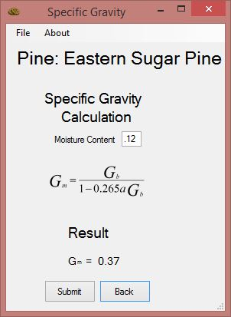
Individual Requirements
Select Grain Type
Default moisture content
Provide Beam Dimensions

Slide 9
Live Demo

Slide 10
Questions?

